Slide 1



TeleBot & Raspberry Pi
By : Naveen Nayan
M.Tech(ES)
Batch(2016 - 2018)
School of Electronics, Devi Ahilya Vishwavidyalaya Indore

Slide 2

What is a Chat Bot ??
A computer program designed to simulate conversation with human users, especially over the Internet. Examples include Apple Siri, Google Allo, Microsoft Cortana etc.
Chat Bot

Slide 3

BotFather is the one bot to rule over all the bot in Telegram you can do all settings like create new bot, generate Token, Set name, image and many more. Use the /newbot command to create a new bot. The BotFather will ask you for a name and username, then generate an authorization token for your new bot.
TOKEN String
483566923:AAGPC0hsawndIyisAcxVYJKwbxZcIksoFMPjntXdVA

Slide 4
Botfather commands
/newbot — command to create a new bot.
/mybots — returns a list of your bots
/setname – change your bot's name.
/setdescription — change the bot's description, a short text of up to 512 characters
/setuserpic — change the bot‘s profile pictures. It’s always nice to put a face to a name.
/setcommands — change the list of commands supported by your bot.
/deletebot — delete your bot and free its username.

Slide 5
Packages or Library
Pip
sudo apt-get install python-pip
Telepot
Pip install telepot
Rpi GPIO
sudo apt-get install rpi.gpio
Python Framework for Telegram Bot API

Slide 6
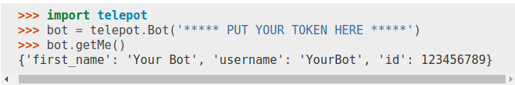
Python Framework for Telegram Bot API
Test the account
>>> import telepot
>>> bot = telepot.Bot("483566923:AAGPAcxVYJKwbxZcIksoFMPjntXdVA")
>>> bot.getMe()
{u'username': u'RpiControlBot', u'first_name': u'RpiControl', u'is_bot': True, u'id': 483566923}

Slide 7
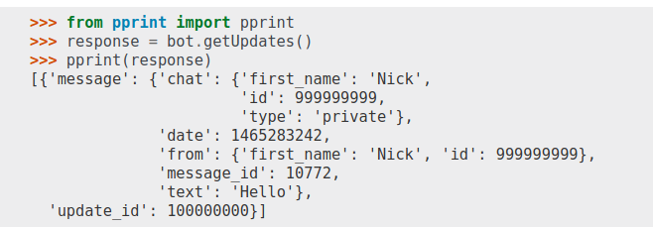
Python Framework for Telegram Bot API
Receive messages
Notes:
The chat field represents the conversation. Its type can be private, group, or channel(whose meanings should be obvious, I hope). Above, Nick just sent a private message to the bot.

Slide 8
Python Framework for Telegram Bot API
Receive messages
>>> from pprint import pprint
>>> response = bot.getUpdates()
>>> pprint(response)
[{u'message': {u'chat': {u'first_name': u'Nayan',
u'id': 265839921,
u'type': u'private',
u'username': u'naveen_nayan'},
u'date': 1516632551,
u'from': {u'first_name': u'Nayan',
u'id': 265839921,u'is_bot': False,
u'language_code': u'en-GB',
u'username': u'naveen_nayan'},u'message_id': 128,u'text': u'hi'},u'update_id': 213993895}]
Notes:
Note the update_id. It is an ever-increasing number. Next time you should usegetUpdates(offset=100000001) to avoid getting the same old messages over and over. Giving an offset essentially acknowledges to the server that you have received all update_ids lower than offset:

Slide 9
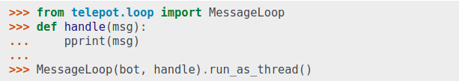
Python Framework for Telegram Bot API
An easier way to receive messages
After setting this up, send it a few messages and monitor the messages arriving. It returns a json with new message we don't need to give offset as chat id. It has id in from key which is sender's id. It is useful to send back a message.
Send a Message using chat id
>>> bot.sendMessage(999999999, 'Hey!')

Slide 10
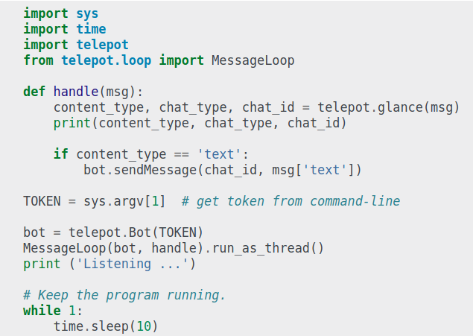
Python Framework for Telegram Bot API
An example of echo Bot

Slide 11
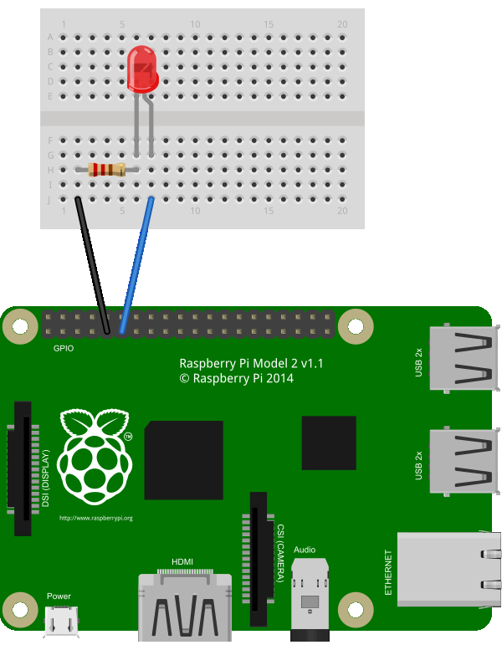
Rpi LED control using TeleBot
import time
import telepot
import RPi.GPIO as GPIO
from telepot.loop import MessageLoop
#LED
def on(pin):
GPIO.output(pin,GPIO.HIGH)
return
def off(pin):
GPIO.output(pin,GPIO.LOW)
Return
# to use Raspberry Pi board pin numbers
GPIO.setmode(GPIO.BOARD)
# set up GPIO output channel
GPIO.setup(11, GPIO.OUT)
https://pastebin.com/h21mdUuk

Slide 12
Rpi LED control using TeleBot
def handle(msg):
print msg
chat_id = msg['chat']['id']
print chat_id
command = msg['text']
print 'Got command: %s' % command
if command == 'on':
bot.sendMessage(chat_id, "set led on")
on(11)
elif command =='off':
bot.sendMessage(chat_id, "set led off")
off(11)
bot = telepot.Bot("************** YOUR TOKEN HERE ***************")
MessageLoop(bot, handle).run_as_thread()
print 'I am listening...'
while 1:
time.sleep(10)
https://pastebin.com/h21mdUuk

Slide 13
Reference
[1]"Bots: An introduction for developers", Core.telegram.org, 2018. [Online]. Available: https://core.telegram.org/bots#6-botfather.
[3]"Bots: An introduction for developers", Core.telegram.org, 2018. [Online]. Available: https://core.telegram.org/bots#6-botfather.
[2]"Introduction — telepot 12.5 documentation", Telepot.readthedocs.io, 2018. [Online]. Available: http://telepot.readthedocs.io/en/latest/#.
[4]"Introduction — telepot 12.5 documentation", Telepot.readthedocs.io, 2018. [Online]. Available: http://telepot.readthedocs.io/en/latest/#.

